Slide 1
Programming in QTP - II

Slide 2
Programming in QTP - II
Methods
User – Defined Functions

Slide 3
Inserting Methods
Instead of recording, you can add steps to your tests using the Method wizard.
You can use the Method wizard to insert statements while recording or afterwards.
To activate the Method wizard:
  Insert > Step > Method.
  Click on the object in your application for which you want to enter a method statement.
  QuickTest returns to focus and the Object Selection
  Select the object for which you want to insert a statement. Click OK.

Slide 4
Built - in Functions

Slide 5
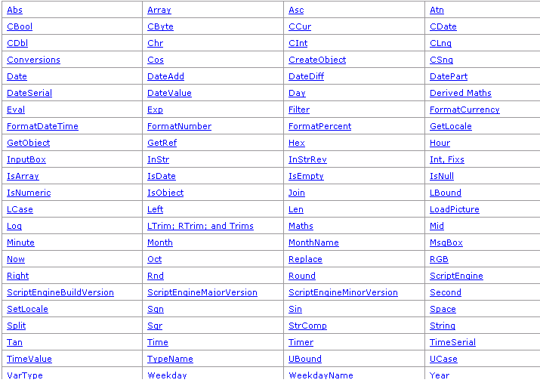

Slide 6
User - Defined Functions
If you have large segments of code that you need to use several times in one test or in several different tests, you may want to create a user-defined function in order to make your tests easier to design and to read.
You can define these functions within an individual test, so that you can access them from any test.

Slide 7
Thank You

